Slide 1



GenAI
Project.
2026
SARCASM DETECTION
DISTILBERT FINE-TUNING FOR GERMAN DIALECTS
Presented By:

Slide 2
01
Core Problems &
Project Objectives
OVERVIEW
02
2026
Data
03
03
Methodology
Within the Streamlit web application
Project.
04
Project Workflow
05
Preliminary Results
GenAI
06
Reflection

Slide 3
01
2026
CORE PROBLEMS
CONTEXT
Sarcasm is one of the hardest tasks for AI because the meaning is often the opposite of the words used
Project.
THE DIALECT GAP
Most German AI is trained on "Hochdeutsch" (Standard German)
GenAI

Slide 4
02
GenAI
Project.
2026
PROJECT OBJECTIVES
01
02
03
FINE-TUNE THE DISTILBERT TRANSFORMER ARCHITECTURE ON THE GERMAN-LANGUAGE MULTIPICO DATASET TO SPECIALIZE IN SARCASM CLASSIFICATION
EVALUATE MODEL PERFORMANCE IS TO BE BASED ON THE F1-SCORE METRIC
IMPLEMENT THE MODEL WITHIN A STREAMLIT WEB APPLICATION
03

Slide 5
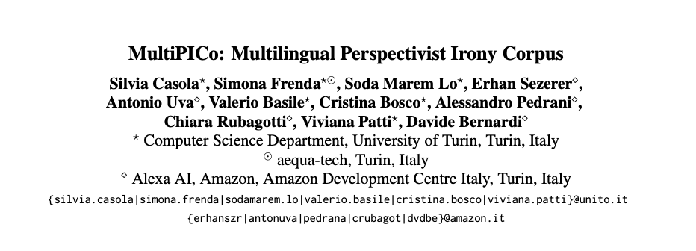

GenAI
Project.
2026
DATA SOURCE
A DISAGGREGATED MULTILINGUAL CORPUS FOR IRONY DETECTION
CONTAINS:
18,778 PAIRS OF SHORT CONVERSATIONS (POST-REPLY) FROM TWITTER (8,956) AND REDDIT (9,822)
DEMOGRAPHIC INFORMATION OF EACH ANNOTATOR (AGE, NATIONALITY, GENDER, AND SO ON)
SUPPORTED TASKS AND LEADERBOARDS
IRONY CLASSIFICATION TASK USING SOFT LABELS (I.E., DISTRIBUTION OF ANNOTATIONS) OR HARD LABELS (I.E., AGGREGATED LABELS)
03

Slide 6
04
A
Data Categorization
D
Optimized Training
PROJECT
WORKFLOW
B
Preprocessing & Tokenization
E
Performance Checkpoint
CODE PIPELINE
C
F
Bias Analysis & Interpretability
Model Initialization
GenAI
Project.
2026

Slide 7
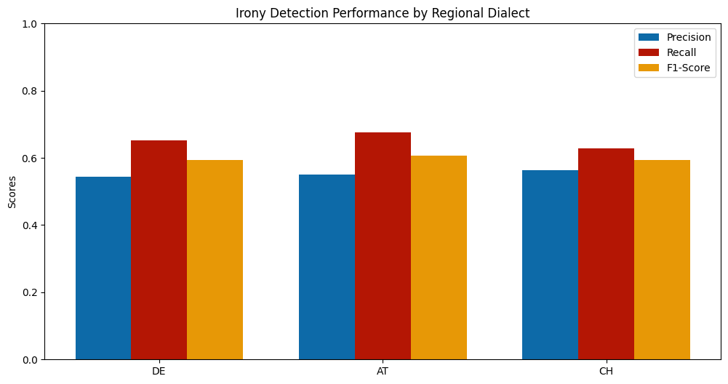
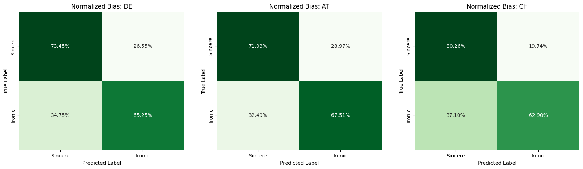
05
PRELIMINARY RESULTS
Project.
GenAI

Slide 8
06
GenAI
Project.
2026
STRENTHS & LIMITATIONS
A BALANCED PERSPECTIVE
STRENGTHS
LIMITATIONS
Granular Insight: Unlike standard NLP, this approach "slices" data by variety, uncovering hidden biases that a single accuracy score would hide.
Methodological Rigor: The use of Early Stopping and weighted loss ensures that the model is statistically sound and not merely memorizing the majority class.
Context Scarcity: BERT models analyze single sentences; however, sarcasm often relies on a conversation's history, which is lost in this dataset.
Pre-training Bias: Because the base model was pre-trained on massive corpora of Standard German (Wikipedia/News), it possesses an inherent "Standard" bias that fine-tuning alone cannot fully erase.

Slide 9
THE "BLACK BOX" PROBLEM
DATA PRIVACY
The "Black Box" Problem: Relying on BERT without interpretability tools like SHAP is ethically risky, as researchers may inadvertently propagate biases without knowing which words the model is penalizing.
Using social media comments for research requires careful anonymization to prevent the doxxing of individuals whose dialects make them easily identifiable.
2026
ETHICAL CONSIDERATIONS
Project.
LINGUISTIC MARGINALIZATION
07
If an AI model consistently misinterprets regional dialects, it risks "silencing" those voices in automated moderation systems or sentiment analysis.
GenAI

Slide 10
GenAI
Project.
2026
09
1
Balanced Fine-Tuning
2
Multimodal Analysis
3
Steamlit Application
PLANS & ASPIRATIONS
4
Deeper Comparative Linguistic Research

Slide 11

THANK YOU

